Slide 1
Overfitting in Neural Networks

Slide 2
Introduction
A model is said to be a good machine learning model if it generalizes any new input data from the problem domain in a proper way.
This helps us to make predictions about future data, that the data model has never seen.

Slide 3
When creating a model, our main goal is to capture the relationship of our data.

Slide 4

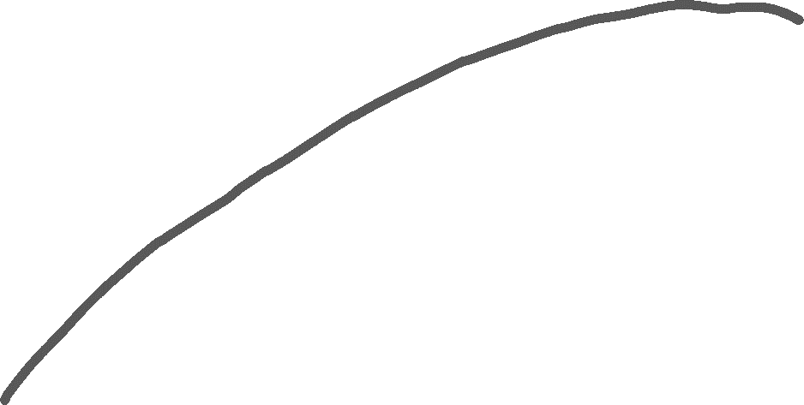
If we are able to create a model that captures the True relationship curve of the data, then we can say that our model generalizes well.

Slide 5
Introduction
Suppose we want to check how well our machine learning model learns and generalizes to the new data. For that, we have overfitting and underfitting, which are majorly responsible for the poor performances of the machine learning algorithms.

Slide 6
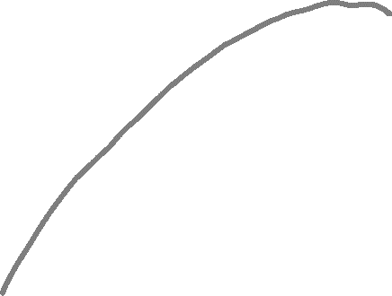
What is Overfitting?
Overfitting is an undesirable machine learning behavior that occurs when the machine learning model gives accurate predictions for training data but not for unseen data.
Overfitted model
True
function

Slide 7


A overfitted model represented by the red broken line fully captures the relationship of the training data

Slide 8
But will fail to generalize when test data (unseen data) is used.

Slide 9
A underfitted model represented by the red line will fail to capture the relationship of both the training data and test data

Slide 10
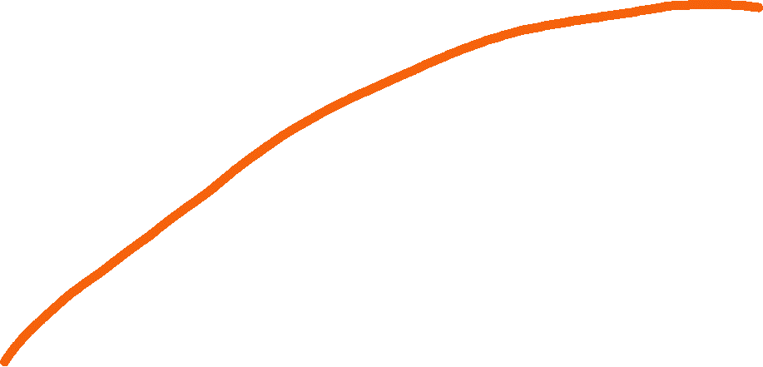
A good fitting model represented by the orange line will capture the relationship of both the training data and test data similar to the true relationship curve

Slide 11
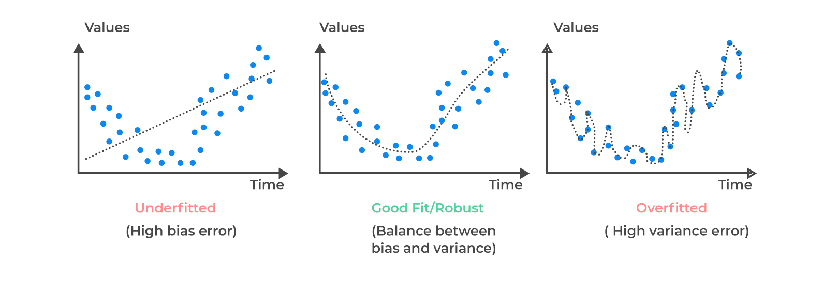
What is Overfitting?

Slide 12
What is Overfitting?

Slide 13
Why does overfitting occur?
The training data size is too small and does not contain enough data samples to accurately represent all possible input data values.
The training data contains large amounts of irrelevant information, called noisy data.
The model trains for too long on a single sample set of data.
The model complexity is high (e.g. too many neurons, too many hidden layers), so it learns the noise within the training data.

Slide 14
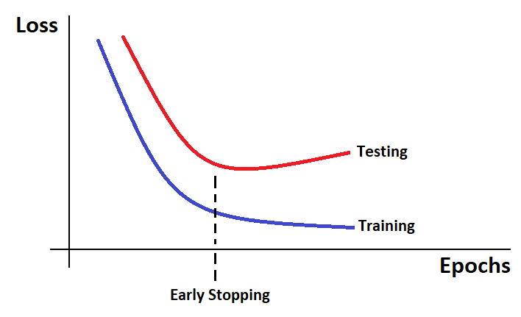
How to reduce Overfitting?
Regularization by dropout
Regularization by early stopping

Slide 15
Dropout
When using dropout, we add a dropout layer which has neurons that randomly shut down at each training step by zeroing out the neuron values.
The fraction of neurons to be zeroed out is known as the dropout rate

Slide 16
Dropout
By using dropout, in every iteration, you will work on a smaller neural network than the previous one and therefore, it approaches regularization.

Slide 17












Epoch: 0
$$h_{1}$$
$$h_{5}$$
$$x_{1}$$
$$h_{2}$$
$$h_{6}$$
$$x_{2}$$
$$\hat{p_{i}}$$
$$h_{3}$$
$$h_{7}$$
$$x_{3}$$
$$h_{4}$$
$$h_{8}$$
Input Layer
Hidden Layer
Dropout Layer
Output Layer

Slide 18
Epoch: 1
$$h_{1}$$
$$h_{5}$$
$$x_{1}$$
$$h_{2}$$
$$h_{6}$$
$$x_{2}$$
$$\hat{p_{i}}$$
$$h_{3}$$
$$h_{7}$$
$$x_{3}$$
$$h_{4}$$
$$h_{8}$$
Input Layer
Hidden Layer
Dropout Layer
Output Layer

Slide 19
Epoch: 2
$$h_{1}$$
$$h_{5}$$
$$x_{1}$$
$$h_{2}$$
$$h_{6}$$
$$x_{2}$$
$$\hat{p_{i}}$$
$$h_{3}$$
$$h_{7}$$
$$x_{3}$$
$$h_{4}$$
$$h_{8}$$
Input Layer
Hidden Layer
Dropout Layer
Output Layer

Slide 20
Early Stopping
In Regularization by Early Stopping, we stop training the model when the performance on the validation set is getting worse increasing loss decreasing accuracy, or poorer scores of the scoring metric.

Slide 21
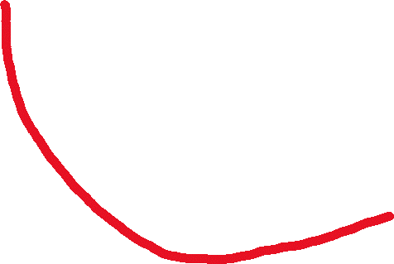
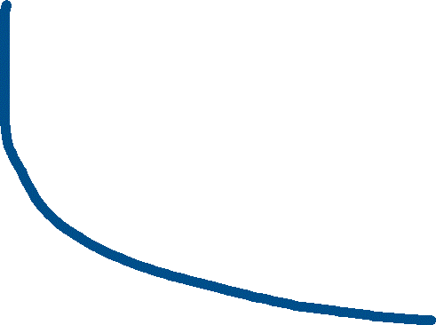
Loss
Test Loss
Training Loss
Epochs

Slide 22


Stop training the neural network at this point .
Loss
Test Loss
Training Loss
Epochs

